Slide 1
.REACT
Lesson 3: Single Page Applications

Slide 2
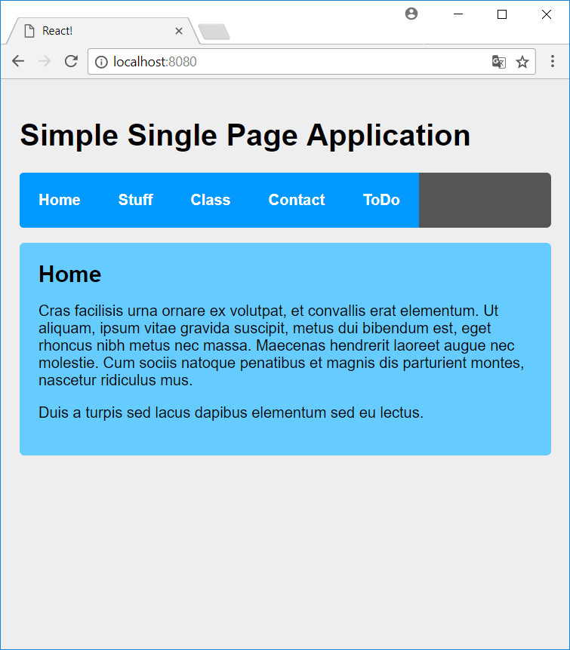
Single Page Applications
React Router
BrowserRouter
Routes
Link
Updating Arrays in State
Manipulating the DOM with Refs

Slide 3
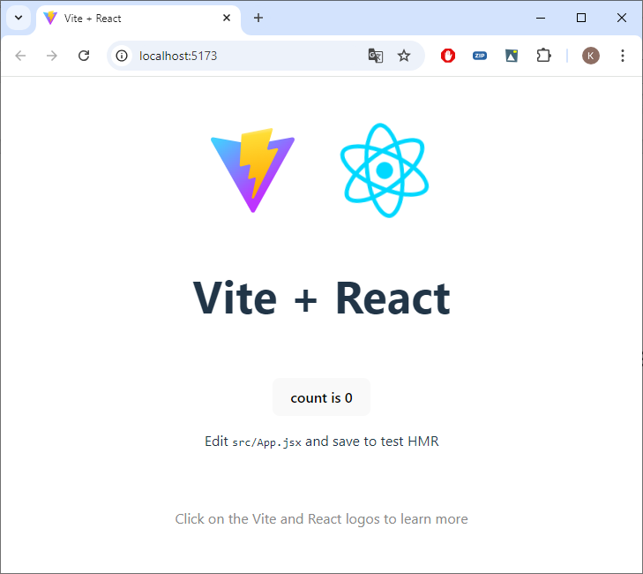
Create React App
npm create vite@latest lesson3 -- --template react

Slide 4
Resources
Copy
App.jsx from Resources to src
index.css from Resources to src
components from Resources to src
data from Resources to src

Slide 5
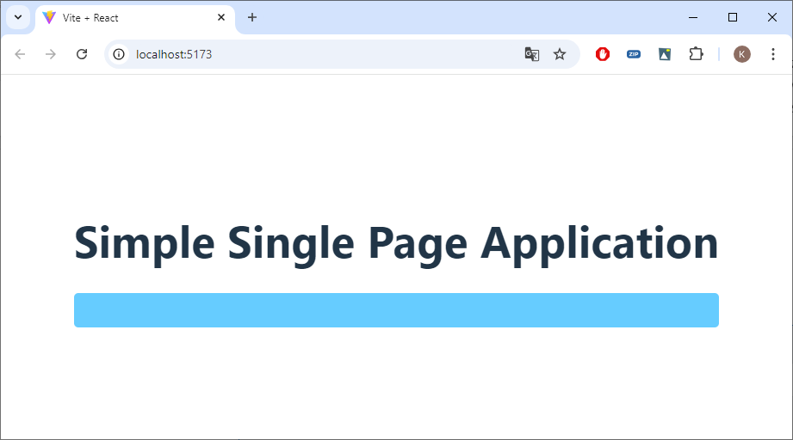
localhost

Slide 6
Installing React Router
npm install react-router-dom

Slide 7
App.jsx
function App() {
return (
<div>
<Header />
<Main />
</div>
);
}
function Header() {
return (
<div>
<h1>Simple Single Page Application</h1>
<ul className="header">
</ul>
</div>
);
}
function Main() {
return (
<div className="content">
</div>
);
}

Slide 8
React Router (App.jsx)
import { Outlet, Routes, Route, BrowserRouter, Link } from 'react-router-dom';
function App() {
return (
<BrowserRouter>
<Header />
<Main />
</BrowserRouter>
);
}
Notes:
import { Outlet, Routes, Route, BrowserRouter, Link } from 'react-router-dom';
function App() {
return (
<BrowserRouter>
<Header />
<Main />
</BrowserRouter>
);
}

Slide 9
React Router
function Header() {
return (
<div>
<h1>Simple Single Page Application</h1>
<ul className="header">
<li><Link to="/" className="active">Home</Link></li>
<li><Link to="/stuff" className="active">Stuff</Link></li>
<li><Link to="/class" className="active">Class</Link></li>
<li><Link to="/contact" className="active">Contact</Link></li>
<li><Link to="/todo" className="active">ToDo</Link></li>
</ul>
</div>
);
}
Notes:
<li><Link to="/" className="active">Home</Link></li>
<li><Link to="/stuff" className="active">Stuff</Link></li>
<li><Link to="/class" className="active">Class</Link></li>
<li><Link to="/contact" className="active">Contact</Link></li>
<li><Link to="/todo" className="active">ToDo</Link></li>

Slide 10
React Router
function Main() {
return (
<div className="content">
<Routes>
<Route path={'/'} element={<Home/>}/>
<Route path={'/stuff'} element={<Stuff/>}/>
<Route path={'/contact'} element={<Contact/>}/>
<Route path={'/class'} element={<Class/>}/>
<Route path={'/todo'} element={<TodoList/>}/>
</Routes>
</div>
);
}
Notes:
<Routes>
<Route path={'/'} element={<Home/>}/>
<Route path={'/stuff'} element={<Stuff/>}/>
<Route path={'/contact'} element={<Contact/>}/>
<Route path={'/class'} element={<Class/>}/>
<Route path={'/todo'} element={<TodoList/>}/>
</Routes>

Slide 11
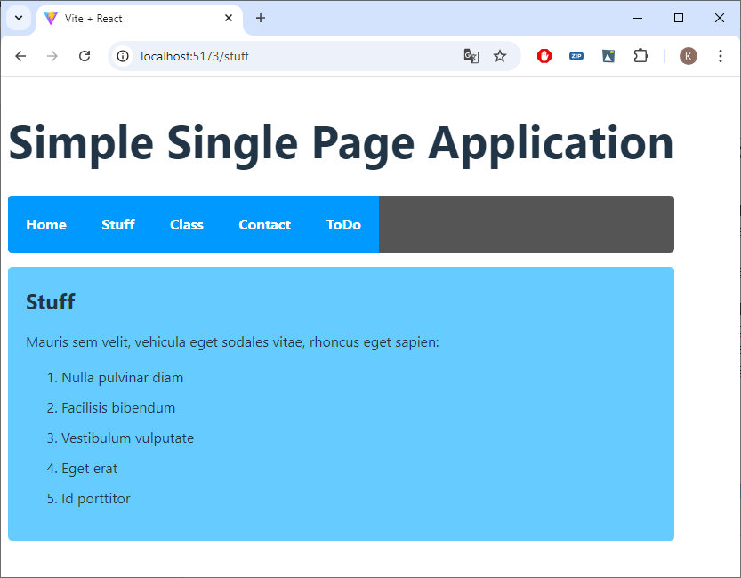
React Router

Slide 12
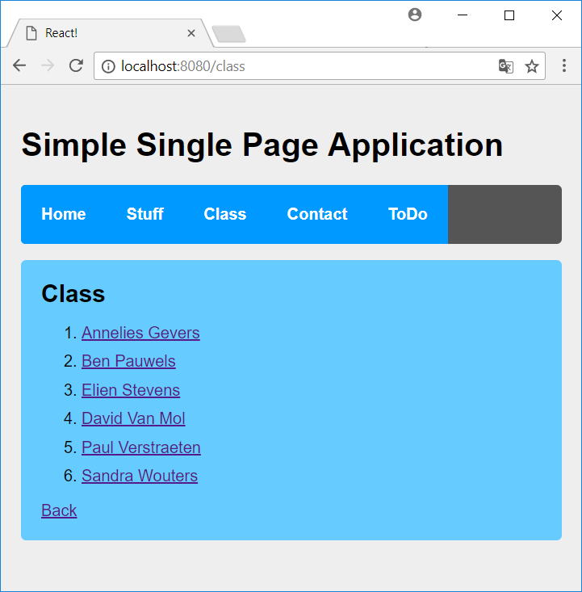
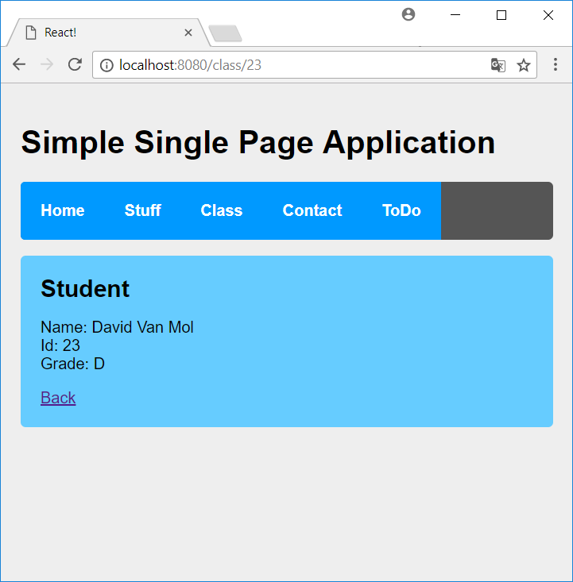
Route Parameters

Slide 13
Nested Routes (App.jsx)
<Outlet /> in the parent route will render one of the child route elements (don't forget to import)
If the parent route matched exactly, it will render a child index route.
<Route path={'/class'} element={<Outlet />}>
<Route index element={<Class />}/>
<Route path={':id'} element={<Student />}/>
</Route>
Notes:
<Route path={'/class'} element={<Outlet />}>
<Route index element={<Class />}/>
<Route path={':id'} element={<Student />}/>
</Route>

Slide 14
studentapi.js
const students = [
{id: 565, name: "Annelies Gevers", grade: "A-"},
{id: 11, name: "Ben Pauwels", grade: "A+"},
{id: 91, name: "Elien Stevens", grade: "F"},
{id: 23, name: "David Van Mol", grade: "D"},
{id: 4002, name: "Paul Verstraeten", grade: "F"},
{id: 8, name: "Sandra Wouters", grade: "D-"}
];
export function getAllStudents() {
return students;
}
export function getStudentById(id) {
return students.find((s) => s.id === id);
}

Slide 15
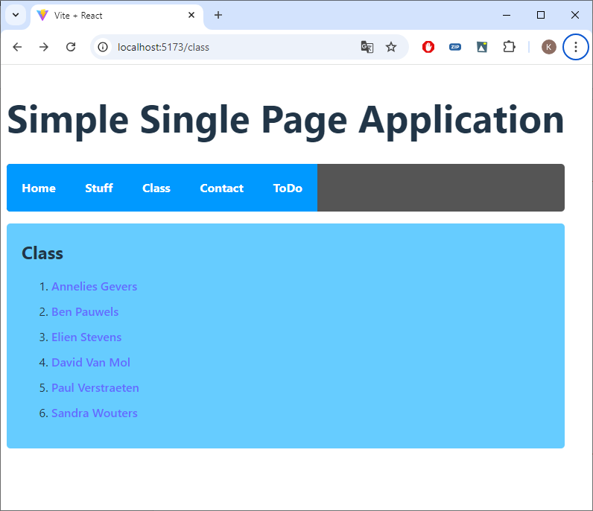
class.jsx
import { Link } from 'react-router-dom';
import { getAllStudents } from '../data/student_api';
function Class() {
const output = getAllStudents().map( (student) => {
return (
<li>
<Link to={"/class/" + student.id}>{student.name}</Link>
</li>
);
});
…
}
Notes:
import { Link } from 'react-router-dom';
const output = getAllStudents().map( (student) => {
return (
<li>
<Link to={"/class/" + student.id}>{student.name}</Link>
</li>
);
});

Slide 16
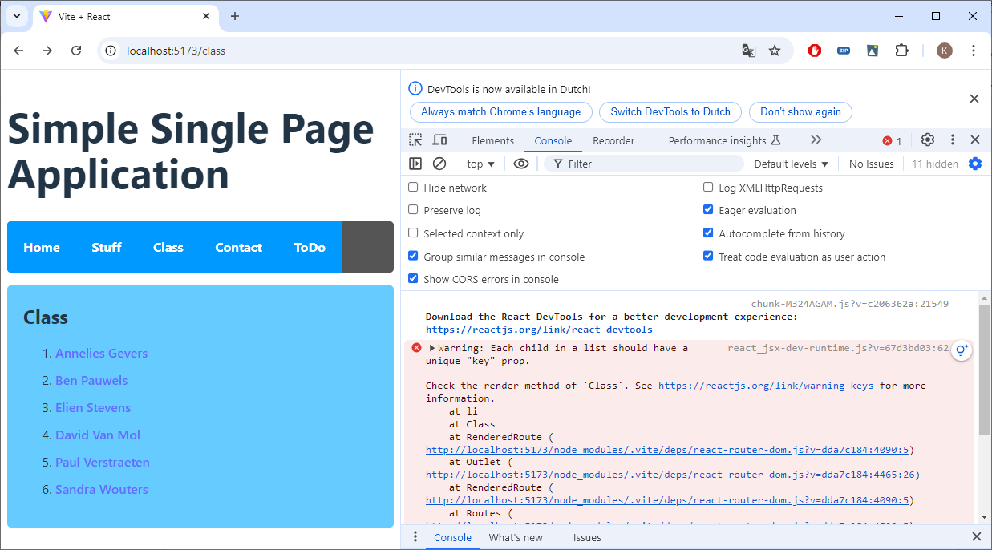
Correct the Warning!

Slide 17
useNavigate
import { useNavigate } from 'react-router-dom';
...
function Class() {
const navigate = useNavigate();
...
return (
<div>...
</ol>
<Link onClick={() => navigate(-1)}>Back</Link>
</div>
);
}
The useNavigate hook returns a function that lets you navigate programmatically
Either pass a To value (same type as <Link to="...">)
Ex. navigate('/stuff')
Pass the delta you want to go in the history stack. For example, navigate(-1) is equivalent to hitting the back button.
Notes:
import { useNavigate} from 'react-router-dom';
const navigate = useNavigate();
<Link onClick={() => navigate(-1)}>Back</Link>

Slide 18
useParams
The useParams hook returns an object of key/value pairs of the dynamic params from the current URL that were matched by the <Route path>
<Route path={'/class'} element={<Outlet />}>
<Route index element={<Class />}/>
<Route path={':id'} element={<Student />}/>
</Route>
const {id} = useParams(); // returns {id: 23}

Slide 19
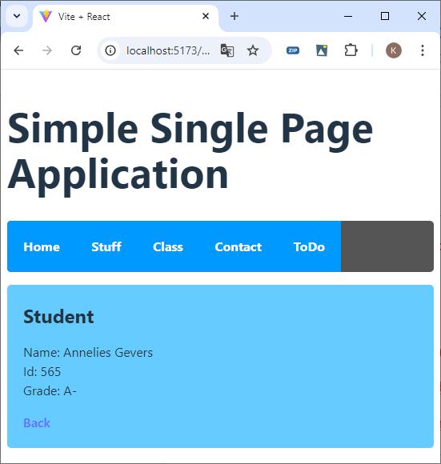
student.jsx
import { useNavigate, useParams } from 'react-router-dom';
import { Link } from 'react-router-dom';
import { getStudentById } from '../data/student_api';
function Student() {
const {id} = useParams();
const navigate = useNavigate();
const student = getStudentById(Number(id));
if (!student) {
return <div>Student does not exist</div>
}
Notes:
import { useNavigate, useParams } from 'react-router-dom';
import { Link } from 'react-router-dom';
const {id} = useParams();
const navigate = useNavigate();
const student = getStudentById(Number(id));
if (!student) {
return <div>Student does not exist</div>
}

Slide 20
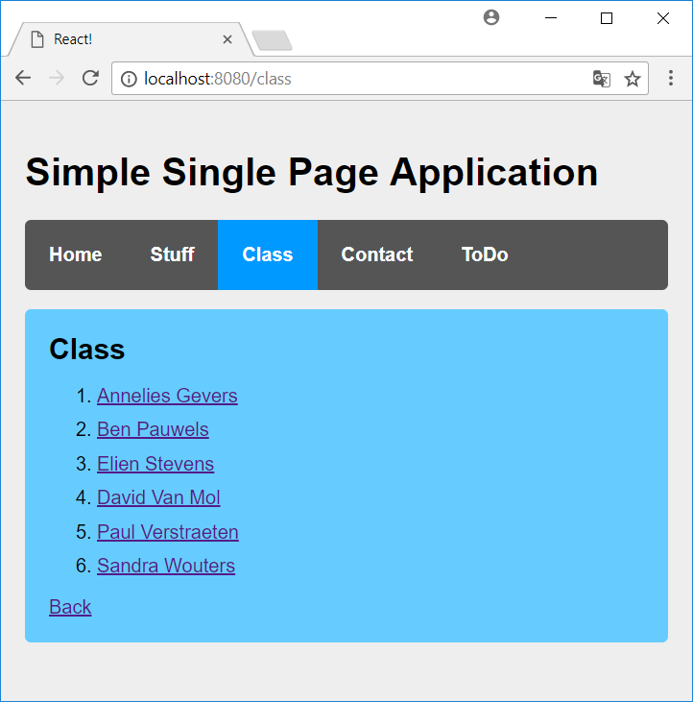
Link ⇨ NavLink
Notes:
className={({ isActive }) => isActive ? "active" : undefined}

Slide 21
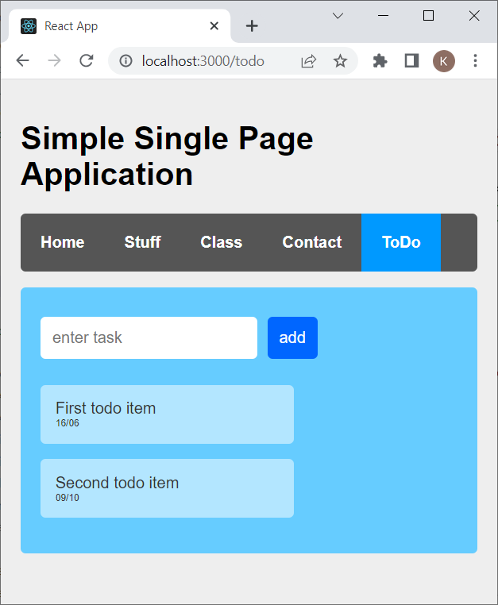
ToDo App
Where do we have to put our state?
Remember? lifting state up
TodoList
Inputform
TodoItems

Slide 22
Give TodoList state
import InputForm from "./input_form";
import TodoItems from "./todo_items";
function TodoList() {
const initial = [ { text: "First todo item", date: "16/06", key: "1" },
{ text: "Second todo item", date: "09/10", key: "2" } ];
return (
<div className="todoListMain">
<InputForm />
<TodoItems />
</div>
);
}
export default TodoList;
Notes:
import { useState } from 'react';

Slide 23
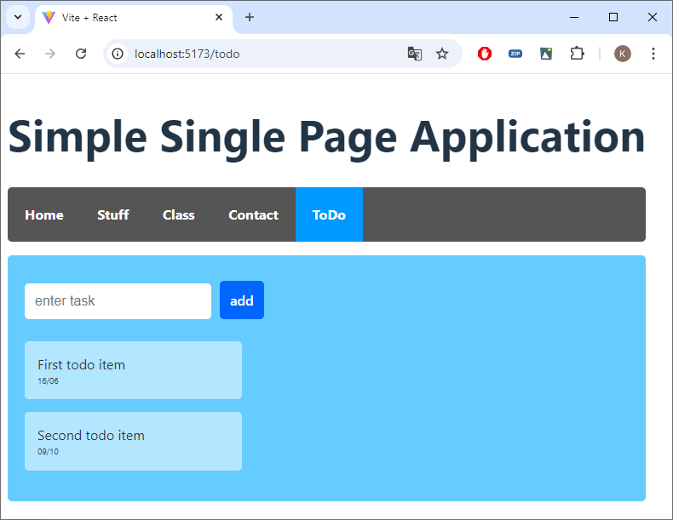
TodoItems
Notes:
const output = items.map ( (item) => {
return (
<li key={item.key}>
{item.text}<br />
<div className="smallerText">
{item.date}
</div>
</li>
)
});

Slide 24
Updating Arrays in State
You should treat arrays as immutable (read-only) when you store them in React state.
This means that you also shouldn’t use methods that mutate the array, such as push() and splice().
The easiest way to remove an item from an array is to produce a new array that will not contain that item.
Set state to use the new array.
const [items, setItems] = useState(initial);
function handleDelete(item) {
setItems(
items.filter(i =>
i.key !== item.key
)
);
}
Notes:
function handleDelete(item) {
setItems(
items.filter(i =>
i.key !== item.key
)
);
}

Slide 25
TodoList
Don't mutate state!
function handleInsert(task) {
const today = new Date();
const shortDate = today.getDate() + "/" + (today.getMonth() + 1)
setItems([
...items,
{ text: task, date: shortDate, key: Date.now() }
]);
}
Notes:
function handleInsert(task) {
const today = new Date();
const shortDate = today.getDate() +
"/" + (today.getMonth() + 1)
setItems([
...items,
{ text: task, date: shortDate, key: Date.now() }
]);
}

Slide 26
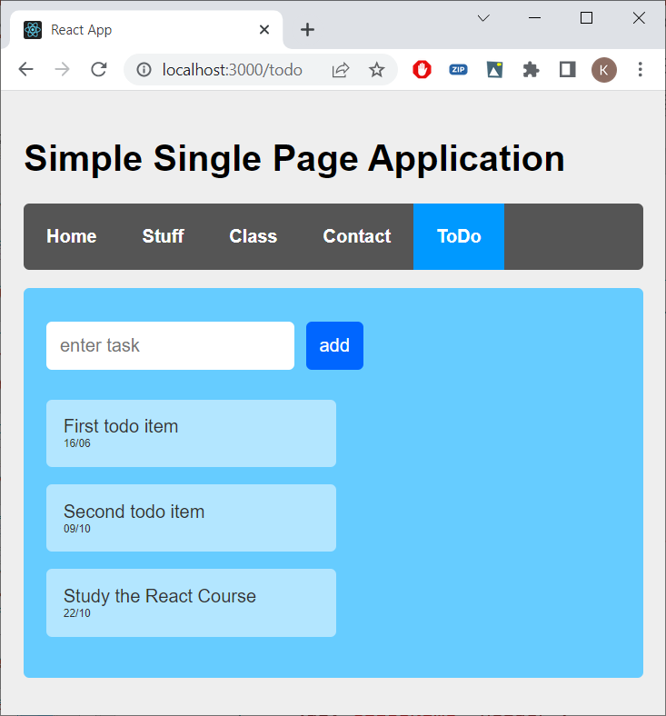
InputForm

Slide 27
Manipulating the DOM with Refs
Sometimes you might need access to the DOM elements (HTML components) managed by React - for example, to focus a node, scroll to it, or measure its size and position.
To access a DOM node (HTML component) managed by React, first, import the useRef Hook
import { useRef } from 'react';
Then, use it to declare a ref inside your React component
const myRef = useRef(null);
Finally, pass it to the DOM node as the ref attribute
<input ref={myRef}>
<form onSubmit={handleSubmit}>
<input
onChange={handleChange}
placeholder="enter task" />
<button type="submit">add</button>
</form>
Notes:
import { useRef } from 'react';
const inputRef = useRef(null);
<input
ref={inputRef}
inputRef.current.focus();

Slide 28
Exercise
Capitals

